Slide 1
Access the slides and files here:
https://github.com/j-berg/rutter_lab_coding_bootcamp
Or on fileserver at LAB INFO > Jordan’s Coding Bootcamp > Zoom

Slide 2
Rutter Lab Isolation Bootcamp
#4: Sequencing workflow and files

Slide 3
scp – secure copying between your computer and the supercomputer
$ scp ./*bam uNID@notchpeak.chpc.utah.edu:~/test_files
$ scp uNID@notchpeak.chpc.utah.edu:~/ test_files/*bam ./

Slide 4
Sequencing and Bioinformatics Files

Slide 5
Sequencing basics
https://en.wikipedia.org/wiki/RNA-Seq#/media/File:Journal.pcbi.1004393.g002.png

Slide 6
FASTQ
@SRR2075930.2:UMI_NTGCG HS1:450:C5WTEACXX:7:1101:1276:2113 length=50
CTACGTGTGGAGGCTCANGCAGCGCTTCTGGCTGGAACGGGGAA
+
:@<??@?:>??<=??@>#189==?????>?<??<??>??55985
Line 1: read ID (will start with an @)
Line 2: read sequence
Line3: spacer (sometimes will have the the read ID repeated)
Line4: The corresponding PHRED score

Slide 7
PHRED
Base call confidence score
ASCII characters alongside the read sequences
https://en.wikipedia.org/wiki/Phred_quality_score
https://en.wikipedia.org/wiki/Fred_Flintstone#/media/File:Fred_Flintstone.png

Slide 8
The inner workings of a FASTQ file
$ cat sample.fastq | less -S
You will often get this files gzipped. Some tools will allow for compressed files, others need the files decompressed first, so be sure to check the documentation for file requirements

Slide 9
Pre-processing reads for alignment
Quality – we want bases we are confident in
Length – are the reads too short? They might be a digested fragment or other noise
UMIs – did we use unique molecular identifiers for demultiplexing of reads?
Adapters – What are the adaptors used in sequencing prep?
Notes:
Comparison of different aligners

Slide 10
Pre-processing reads for alignment
$ fastp –help
Short and long flag options
-o == --output
$ fastp -i input.fastq -o processed_reads.fastq -q 28 -l 17 -a ATCGCGATAGCTAGA
* If you ran 50 bp RNA-seq, maybe you want to set -l to 35 or 40

Slide 11
Generating a genome index
RNA-seq: we will have intron-spanning reads, so need software that can handle that
Genome seq: not worries about intron-spanning reads, so we have other options there
Indexing:
Compresses genome sequence to index of seed sequences and locations for fast search and determination of read coordinates
Google search: index of search keywords for fast results

Slide 12
FASTA
>record
ATATGTGTATACTCTATAGAGAGGATCTAGAGTATAGC
TCGCGTATAGAGATCTTCGCGATATAGAGAGTCTGCG
AAGGCTCTCGCGCGCAAAGAGAGAGATATTCGCGC
Genome sequence files
Required input for reference file creation

Slide 13
Aligning reads to genome index
$ STAR --runMode genomeGenerate --genomeDir /path/to/output --genomeFastaFiles /path/to/genome/fastas –sjdbGTFfile /path/to/gtf.gtf --runThreadN 40
Genome directory: where do we want to output the index files?
Genome FASTA files: Where are the genome FASTA files needed to build the index?
Splice junction GTF file: If processing RNA-seq, we need a map of known splice junctions to optimize building an index that incorporates this information
Threads: Split the job into multiple smaller jobs and execute simulateously
The supercomputer normally gives you 32-64 cores for job, so you can speed up these long steps
If we don’t have a GTF file for our organism, we can run two-pass alignment (discussed later)

Slide 14
BAM/SAM file
Sequence alignment file
Binary sequence alignment file (using “cat” will print binary gibberish)
Tab-delimited
To view BAM files, we need samtools (downloaded previously)
$ samtools view sample.bam | column -t -s $'\t' | less -N -S
separate out data by tabs

Slide 15
Transcriptome aligned BAM files
$ samtools view sample_transcriptome.bam | head –n 20
Similar to previous format, but alignments are made directly to transcriptome reference (GTF) instead of chromosome coordinates
Can be faster, but may miss information
Each alignment style needs to be considered in downstream processing

Slide 16
Two-pass alignment
Build index with no splice junction information
Take putative splice junctions found through alignment
Re-build index
Re-align
Much longer, but sometimes necessary

Slide 17
Quantification straight from transcriptome-alignment of reads
Reads to isoform abundance
Uses GTF to build index
Much faster
Will miss information on expression if not annotated
See Kallisto

Slide 18
Visualizing read alignment coverage
Download IGV: https://software.broadinstitute.org/software/igv/download
Index BAM file:
$ samtools index filename.bam
Essential creating a map of the file for quicker searching

Slide 19
IGV
Tool for exploring read pile-ups for sequencing data
Notes:
Go to chr 19

Slide 20
Quantifying reads
Can use Kallisto, but if we are quantifying from BAM files, may want to use read quantification tools
Will only give metrics at the gene level
Can specify region to quantify from (whole transcript, exons, CDS)
BAM files contain coordinates, uses these coordinates with GTF reference to determine which gene a read belongs to

Slide 21
Post-processing reads
Alignment files are hefty, need to sort them to make for easier handling of downstream tools
Can sort by read name or by genome coordinates
$ samtools sort --threads 20 -o sorted.bam input.bam
By default, sorts by coordinates
Add ”-n” for sorting by name

Slide 22
$ htseq-count -f bam -m intersection-nonempty -t exon -i gene_id -r pos input_file.bam transcriptome.gtf > output.tsv
-f: input file type
-m: How do we want to quantify reads that overlap two genes? (see htseq documentation for more information)
-t: what feature do we want to quantify with?
-i: What feature ID do we want to use
-r: How were alignment files sorted?
Give BAM file, then GTF file for reference
>: Send alignment results to tab-delimited file

Slide 23
The almighty .txt file
Tabs (.txt, .tsv) over commas (.csv)
References how to determine how to segment the data into rows and columns
Bioinformatics software will almost always require or output plaintext files

Slide 24
Quality control
I like multiQC
Let’s look at an example
Add other metrics depending on experiment

Slide 25
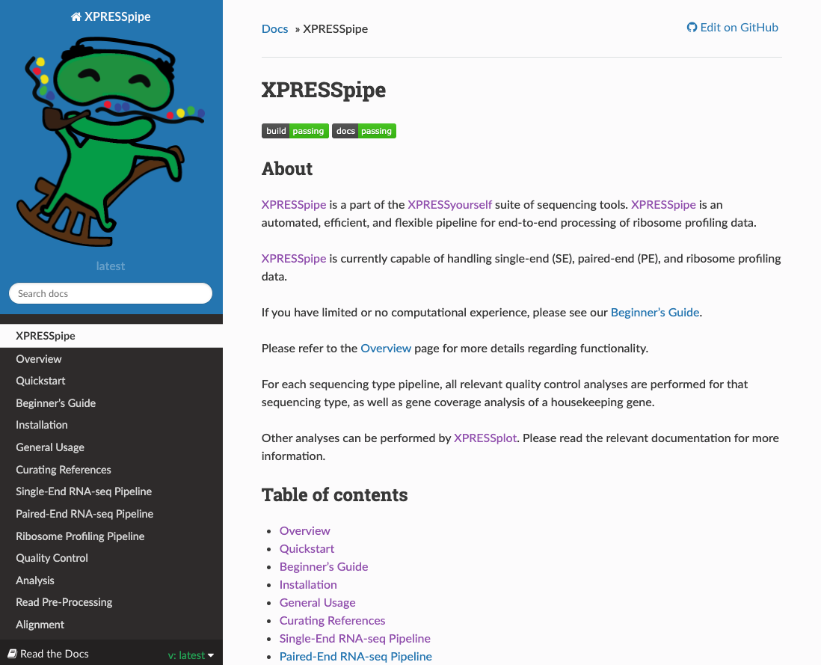
Pipelines – are they right for you?
Read the documentation – what does it do?
Does it do what you need it to?
Is it missing anything? Where can you find the missing parts?

Slide 26
Homework
Review samtools and BAM file format:
http://quinlanlab.org/tutorials/samtools/samtools.html
Skip sections 1.3 & 1.4: https://samtools.github.io/hts-specs/SAMv1.pdf

